Slide 1
A Crash Course of the Middle East

Slide 2
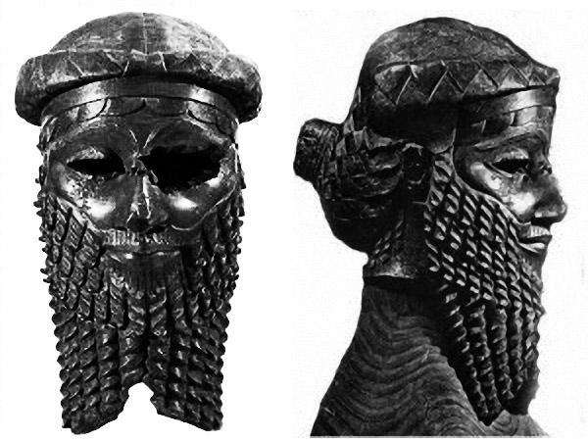
Akkadian Empire – 2350 BCE
A conqueror named Sargon defeated the city-states of Sumer. By taking control of both northern and southern Mesopotamia, Sargon created the first empire.

Slide 3
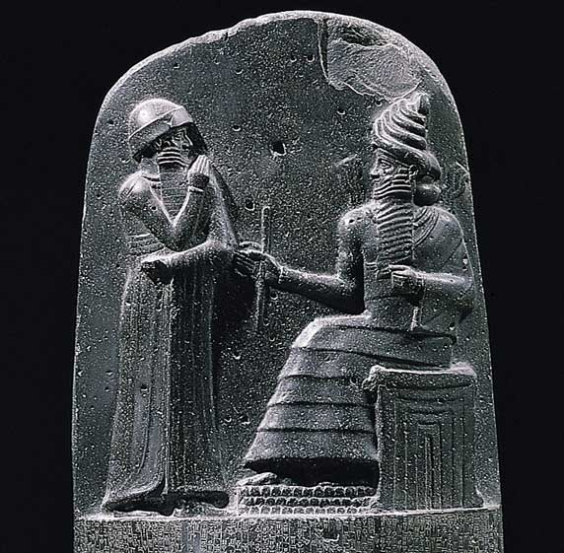
Babylon Empire -2000 BCE
A group of nomadic warriors invaded Mesopotamia and established Babylon as their capital. Hammurabi created his code of conduct as the leader of this empire.

Slide 4
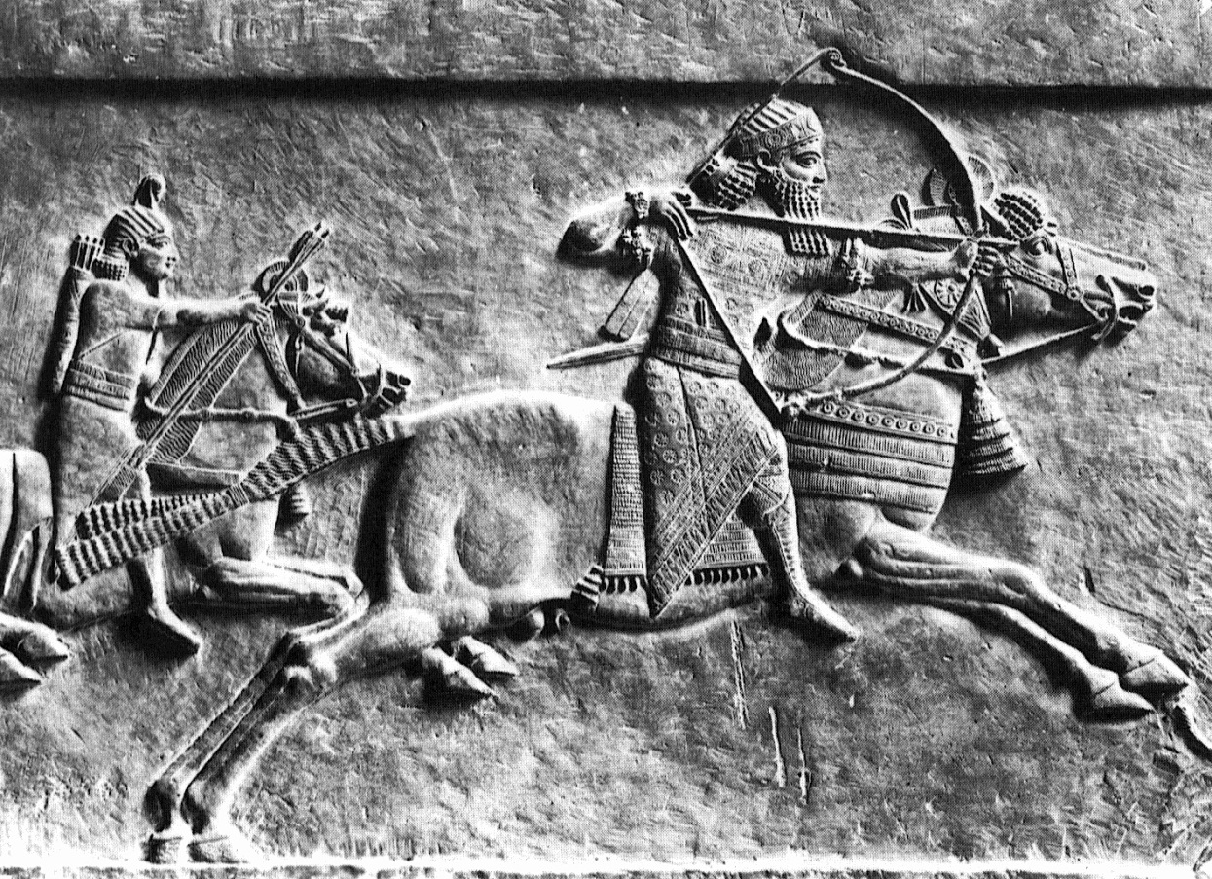
Assyrian Empire 850 BCE
Assyrians took over because their society gloried military strength. They wore copper or iron helmets which made them unstoppable.

Slide 5
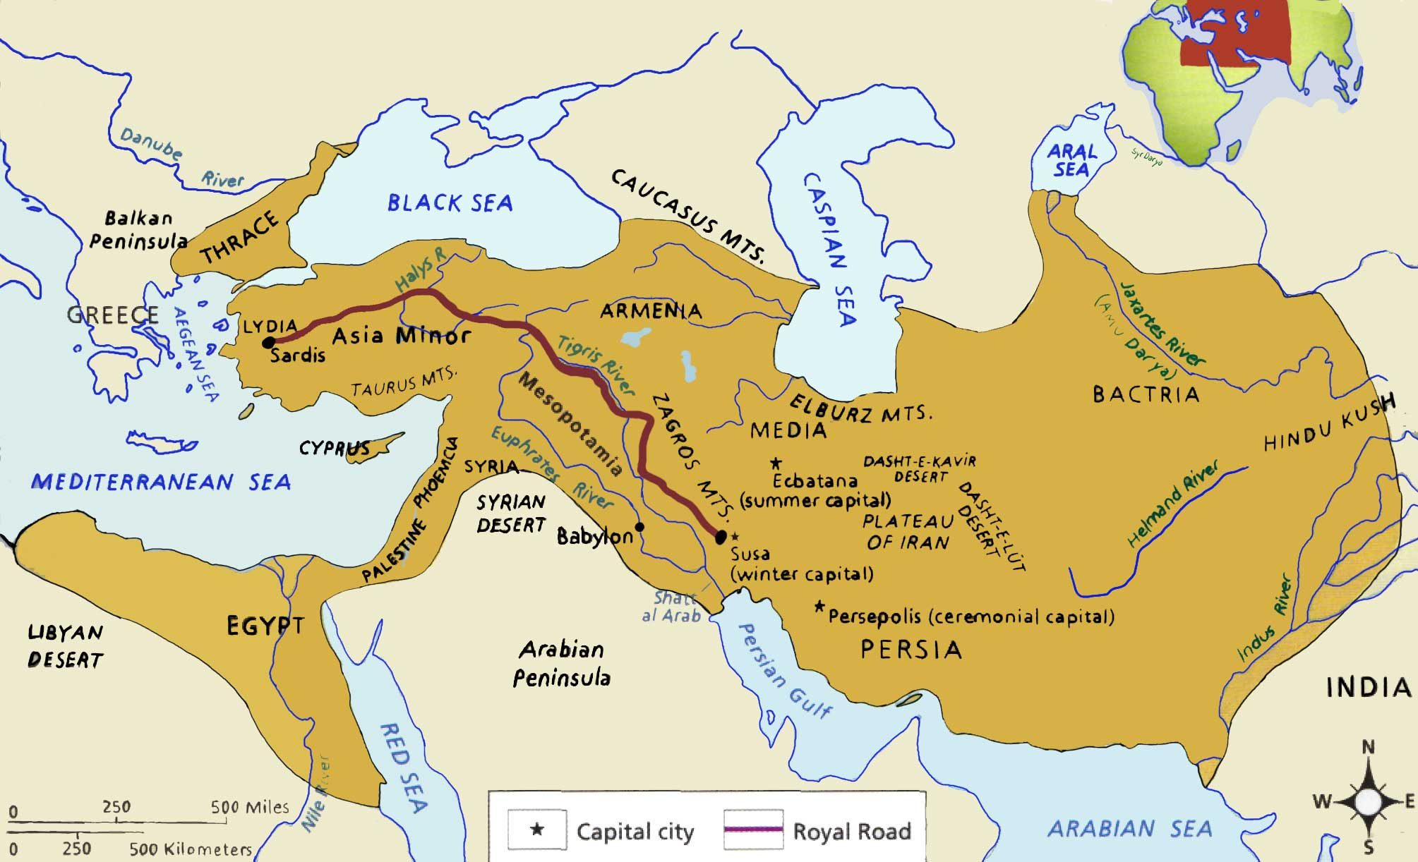
550 BCE Persian Empire
Until Cyrus, a military genius, came along. He created the Persian Empire that spanned more than 2,000 miles. Unlike other conquerors, Cyrus believed in honoring local customs and religions. Instead of destroying local temple, he would kneel and pray there. The conquered were grateful for Cyrus and many considered him a God. Through their tolerance and good government, the Persians brought order and peace to their Empire.

Slide 6
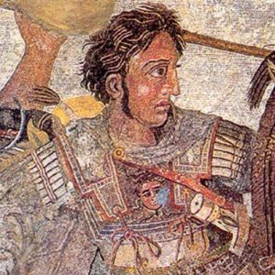
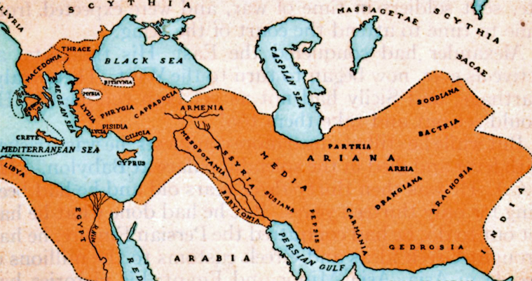
333 BCE Macedonian Empire
A group north of Greece swept through the city-states of Greece and pushed on to conquer all of the Persian Empire lead by a 20 year old named Alexander the Great. As he conquered he created a new culture that blended Greek and Eastern customs.

Slide 7
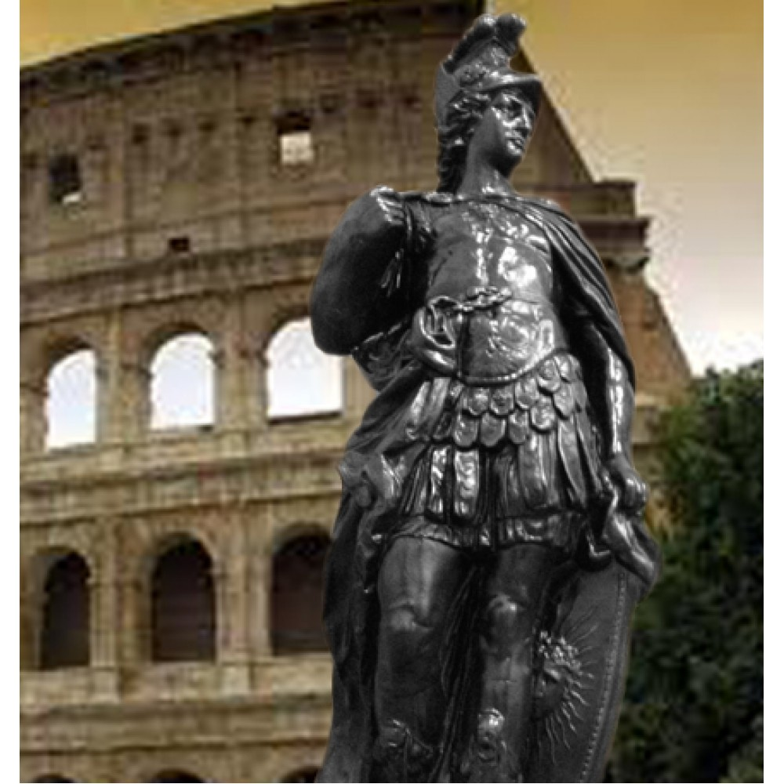
Roman Empire 139 BCE
The Roman Empire included 3 million square miles and controlled up to 80 million people. They influenced all under their empire with slaves, mythology, and a new culture.

Slide 8
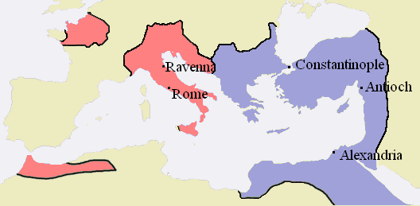
Byzantine Empire 395 AD
The Roman Empire split into two. The eastern half became the Byzantine Empire.

Slide 9
Muhammad 610 AD
In Mecca a 40 year old man named Muhammad received a revelation from a messenger of Allah. He taught that Allah was the one and only God. The teaches of Muhammad is the start of the religion Islam.

Slide 10
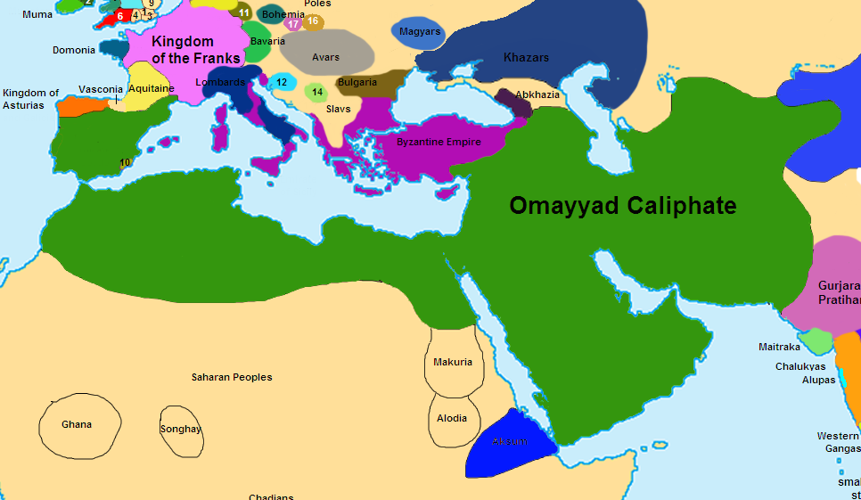
Caliphate 661 AD
Muhammad had expressed a desire to spread Islam to the people north of Mecca. So after he died, his followers spread Muhammad’s message converting many. By 750 AD, the Muslim Empire stretched 6,000 miles. The Caliphate was the leader of the empire.

Slide 11
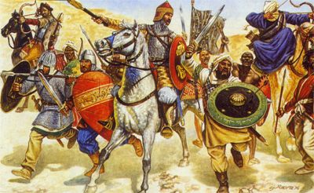
Crusades 1095 AD
A series of wars when the Christians in Europe tried to capture the Holy Land from the Muslims that controlled Jerusalem.

Slide 12
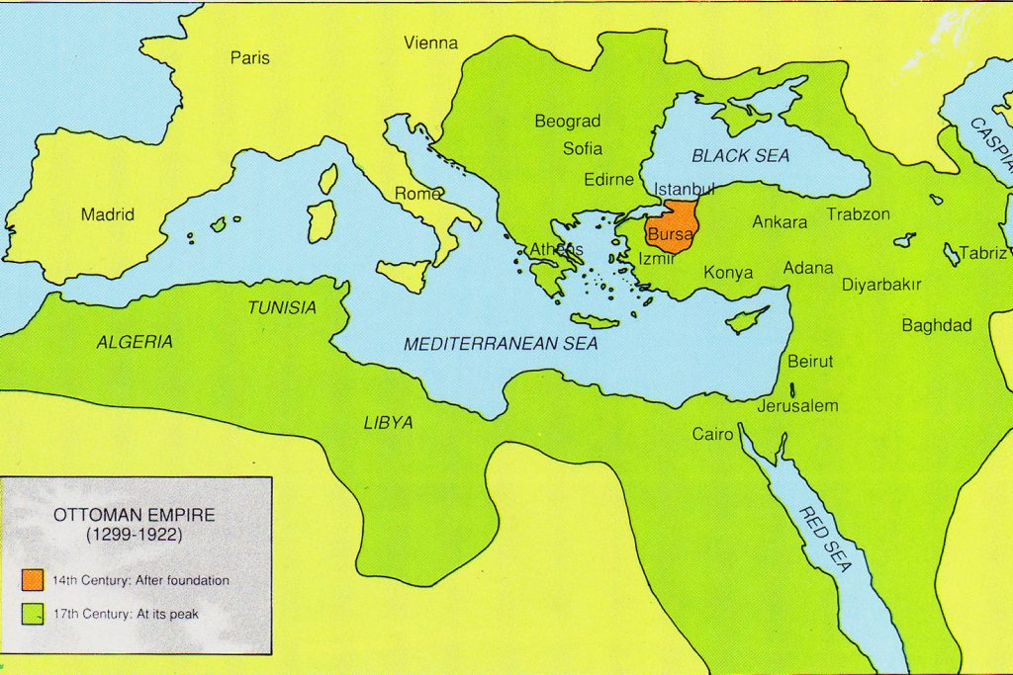
Ottoman Empire 1451 AD
It wasn’t until 1400’s that a group of Muslims called the Ottomans were able to overthrow the Byzantine Empire and unite all of the Middle East under one Muslim lead empire called the Ottoman Empire. The leader declared himself the sultan. None-Muslims were allowed to live in the empire but had to pay more taxes.

Slide 13
European Colonization
Just like when European countries like England, Spain, and France went to colonize the Americas, European countries took over most of the Middle East. (Go to the next slide)

Slide 14
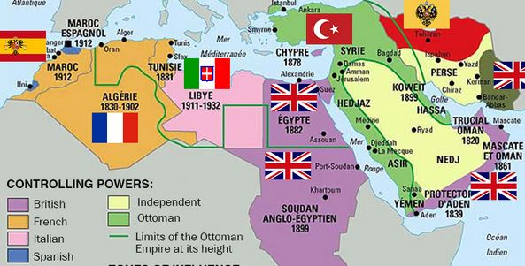
European Colonization 1900
Europe was getting richer and more powerful as it carved up the Middle East into colonial possessions. When World War I ended a few years later, the rest of the defeated Ottoman Empire would be carved up among the Europeans. The lines between French, Italian, Spanish, and British rule are crucial for understanding the region today – not just because they ruled differently and imposed different policies, but because the boundaries between European empires later became the official borders of independence, whether they made sense or not.

Slide 15
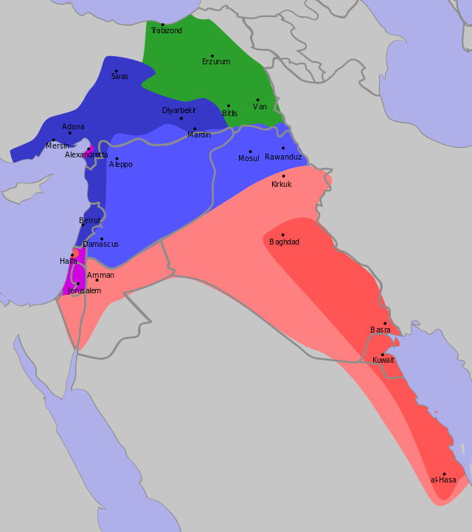
End of WWI 1918
The Ottoman Empire lost in WWI. All of it’s land went to the victors, United Kingdom, France, and Russia. They divide up the land between them.
French: Blue
British: Pink
Russian: Green

Slide 16
The Europeans divided up the Middle East into different countries.
The Sykes-Picot treaty
United Kingdom and French Empires secretly agreed to divide up the Ottoman Empire's regions among themselves. Crucially, the borders between the French and British "zones" later became the borders between Iraq, Syria, and Jordan. Because those later-independent countries had largely made up borders that forced different groups together, and because those groups are still in terrible conflict (hate each other), Sykes-Picot is often thought of as a cause of warfare and violence and extremism in the Middle East.

Slide 17
Here is an example.
Shia and Sunni are 2 different sects of Islam. Sometimes they don’t really like each other. Look at Iraq. The boundaries of Iraq include a lot of both sects. Does that make sense why there is a lot of fighting in Iraq????

Slide 18
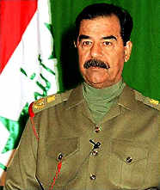
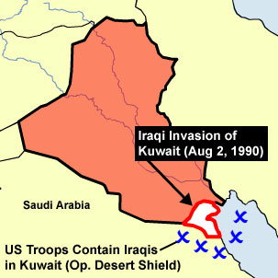
Persian Gulf War 1990
The leader of Iraq, Saddam Hussein tried to take over Kuwait because he felt it was always supposed to be apart of Iraq. United States came in and stopped him.

Slide 19
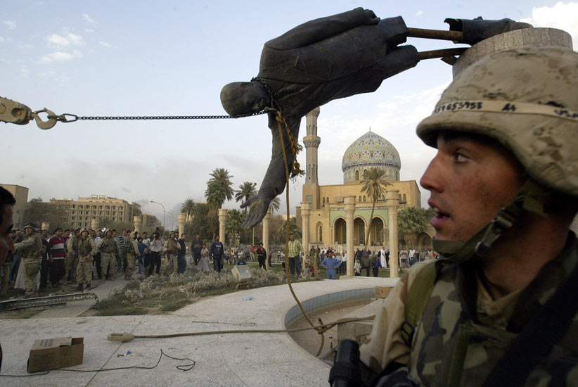
Iraq War 2003
Saddam Hussein didn’t follow the agreements after the Persian Gulf War. He continued to build up an army and hurt people who weren’t like him. After U.S. invaded Iraq they captured Saddam Hussein and he was sentenced to death for killing 183 Shia Muslims. (He was a Sunni)

Slide 20
Check your time line.
All dates labeled correctly
1 fact about each event
All pictures colored
Great. Now complete the Creation of Israel part of the powerpoint.

Slide 21
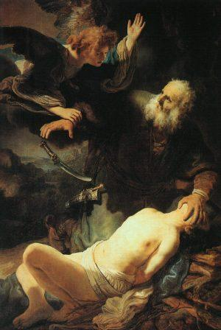
The Creation of Israel
1800 BC – A group of people called the Hebrews(later called the Jews) settled in the land that will later be called the Holy Land. They believe God gave them this land because they are God’s Chosen people.

Slide 22
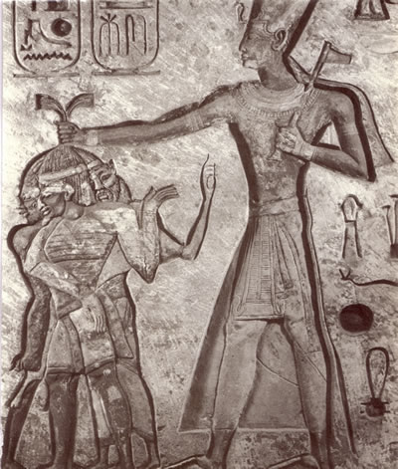
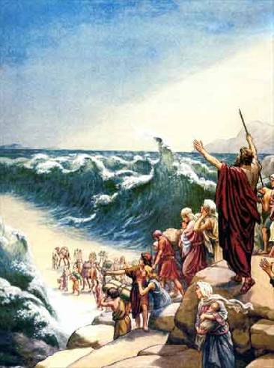
1500 B.C. – Hebrews moved to Egypt because of a drought
1250 – Moses led Hebrews back to the Holy Land
1025 – Formed Kingdoms of Judea and Israel. Kings David and Solomon build the first temple in 1000 BCE

Slide 23
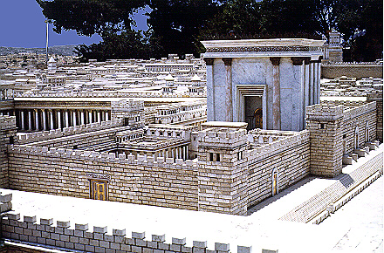
586 B.C. - Conquered by Babylonians –1st temple destroyed – first Diaspora (scattering of people)
539 BC - Babylon falls to Persian Empire
300 BC Persians allowed Hebrews back - built a second temple (165 BC.)
Projected model of the 2nd Temple
Wailing Wall – the remaining remnants of the 2nd Temple.

Slide 24
70 BC Romans destroyed Jerusalem and the second temple - second Jewish Diaspora (scattering Jews to other parts of the world).
Romans renamed the area Syria Palaestina
Most Jews ended up throughout Europe

Slide 25
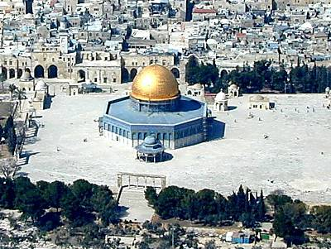
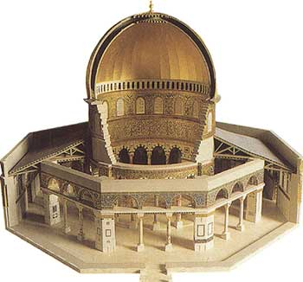
313 AD When the Roman Emperor Constantine converts to Christianity, it centers in the Holy Land.
639 AD – Muslim Arab armies capture the Holy Land and build the Dome of the Rock. The Dome of the Rock is where Muslims believe Abraham almost sacrificed Ishmael.
The Dome of the Rock

Slide 26
1096 AD Pope sends men to recapture the Holy Land (Crusades). Christians did not defeat the Arabs.
So from 639 AD on the Holy Land was called Palenstine.

Slide 27
Late 1800’s: Zionism – a movement among European Jews to set up a Jewish homeland in Palestine (the Holy Land).
The Jews wanted to return to the Holy Land because they were getting persecuted throughout Europe. Many people hated the Jews and blamed them for Jesus Christ’s death.

Slide 28
WWII 1930-40’s: Nazis rise to power – many Jews fled to Palestine to escape the Holocaust.

Slide 29
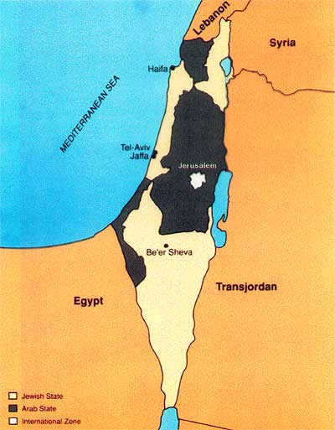
1947 With so many displaced Jews The United Nations decided to split Palestine into a Jewish state and an Arab state.
The Palestinians didn’t want to give up any of their land to the Jews.

Slide 30
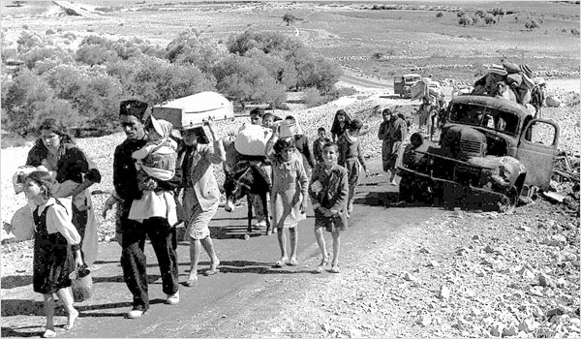
1948 Israeli War for
Independence
Jews announce the creation of Israel.
Arab nations declare war at once, and military forces are sent.
1949 - Israel defeats Arab forces with the help from the U.S.
Arab refugees flee to those three areas.

Slide 31
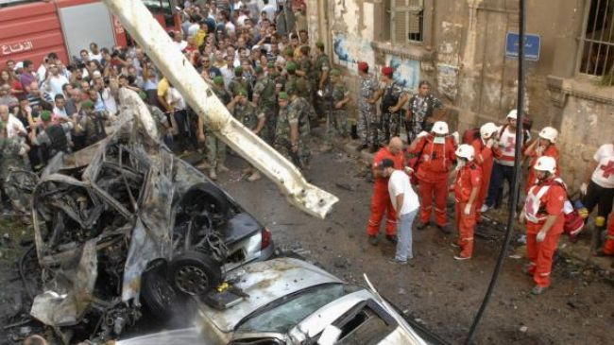
Ever since the Jews and Palestinians have hated each other.
They are constantly fighting.
The Palestinians and other Arabs are mad at the U.S. for supporting Israel.

Slide 32
History of U.S. Government Aid to Israel
U.S. government assistance to Israel began in 1949 with a $100 million Export-Import Bank Loan
From 1949 -1965, U.S. aid to Israel averaged about $63 million a yr, over 95% was economic development assistance and food aid.
Until 2003, Israel received approx. one-third of the annual US foreign aid budget. In 2005, the US gave Israel more than $2.6 billion in aid, a budget exceeded only by US aid to Iraq.
Since World War II, Israel has been the largest overall recipient of US aid:1949-2006 Israel received more than $156 billion of direct US aid.

